Slide 1
Singly linked list

Slide 2
Create singly linked list
public void addNode()
{
System.out.print("Enter value = ");
value=in.nextInt();
ListNode ln=new ListNode(value);
if(head==null)
{
head=ln;
return;
}
ListNode curr=head;
while(curr.next!=null)
{
curr=curr.next;
}
curr.next=ln;
}
class ListNode{
int data;
ListNode next;
public ListNode(int data)
{
this.data=data;
this.next=null;
}
}

Slide 3
Print element
ListNode current=head;
while(current!=null)
{
System.out.print(current.data+"->");
current=current.next;
}
System.out.println("NULL");

Slide 4
find length
int count=0;
ListNode curr=head;
while(curr!=null)
{
count+=1;
curr=curr.next;
}

Slide 5
Insert node at beginning
ListNode node=new ListNode(value);
node.next=head;
Head=node;

Slide 6
Insert node at end
ListNode newnode=new ListNode(value);
if(head==null)
{
head=ln;
return;
}
ListNode current=head;
while(current.next!=null)
{
current=current.next;
}
current.next=newnode;

Slide 7
Insert node at n’th place
if(head!=null)
{
System.out.print("Enter position = ");
int pos=in.nextInt();
System.out.print("Enter value = ");
value=in.nextInt();
int count=1;
ListNode newnode=new ListNode(value);
if (pos==1)
{
newnode.next=head;
head=newnode;
return;
}
ListNode curr=head;
while(count<pos-1)
{
curr=curr.next;
count++;
}
newnode.next=curr.next;
curr.next=newnode;
}
else
System.out.println("Empty list");

Slide 8
Delete from beginning
void deleteFromBegning()
{
if(head!=null)
head=head.next;
else
System.out.println("Empty list");
}

Slide 9
Delete from end
void deleteFromEnd()
{ if(head!=null)
{ if (listCount()==1)
{
head=null;
return;
}
int c=1;
ListNode curr=head;
while(c<listCount()-1)
{
curr=curr.next;
c++;
}
curr.next=null;
}
else
System.out.println("Empty list");
}

Slide 10
Delete from n’th place
if(head!=null)
{
System.out.print("Enter position = ");
int pos=in.nextInt();
int count=1;
if (pos==1)
{
deleteFromBegning();
return;
}
ListNode curr=head;
while(count<pos-1)
{
curr=curr.next;
count++;
}
curr.next=curr.next.next;
}

Slide 11
Reverse
if(head!=null)
{
ListNode curr=head;
ListNode prev=null;
ListNode nextn=null;
while(curr!=null)
{
nextn=curr.next;
curr.next=prev;
prev=curr;
curr=nextn;
}
head=prev;
}
else
System.out.println("Empty list");

Slide 12
Search an element
ListNode current=head;
While(current ! =null)
{
if(current.data==searchkey)
{
return true;
}
current=current.next;
}
return false;

Slide 13
Find middle node in linked list
ListNode slowptr=head;
ListNode fastptr=head;
While(fastptr ! =null && fastptr.next!=null)
{
slowptr=slowptr.next;
fastptr=fastptr.next.next;
}
return slowptr;

Slide 14
Find n’th value from end
ListNode mainptr=head;
ListNode refptr=head;
Int count=0;
While(count<n)
{
refptr=refptr.next;
count++;
}
While(refptr!=null)
{
refptr=refptr.next;
mainptr=mainptr.next;
}
Return mainptr;

Slide 15
Remove duplicate from sorted linked list
ListNode current=head;
While(current!=null && current.next!=null)
{
if(current.data==current.next.data)
{
current.next=current.next.next;
}
else
current=current.next;
}

Slide 16
Insert a node in sorted linked list
ListNode current=head;
ListNode temp=head;
While(current!=null && current.data < newnode.data)
{
temp=current;
current=current.next;
}
Newnode.next=current;
temp.next=newnode;
Return head;

Slide 17
Remove given key in linked list
ListNode current=head;
ListNode temp=null;
While(current!=null && current.data ! = key)
{
temp=current;
current=current.next;
}
If(current==null) return;
temp.next=current.next;

Slide 18
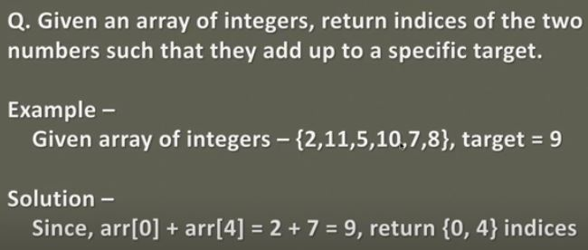
Two sum problem

Slide 19
Two sum problem solution 1
Int number[]={2,11,5,10,5,8};
Int res[]=new int[2];
Map map=new HashMap();
for(int i=0;i<num.length;i++)
{
If(!map.containsKey(target-number[i]))
{
map.put(number[i],i)
}
else{
res[1]=i;
res[0]=map.get((target-number[i]);
return res;
}
}return res;

Slide 20
Two sum problem solution 2
void solve(int arr[],int num)
{
int check=0;
for(int i=0;i<5;i++)
for(int j=0;j<5;j++)
if(i!=j)
if((arr[i]+arr[j])==num)
{
check=1;
System.out.println("sum of indices value = "+i+" "+j+" gives us "+num);
}
if(check==0)
System.out.println("No indices found");
}
int arr[]=new int[5];
Scanner in=new Scanner(System.in);
for(int i=0;i<5;i++)
{System.out.print("Enter numbers = "); arr[i]=in.nextInt(); }
System.out.print("Enter target number = ");
int num=in.nextInt();
for(int i=0;i<5;i++) {
System.out.print(arr[i]+" "); }
System.out.println();
solve(arr,num);

Slide 21
Thank you

